Slide 1
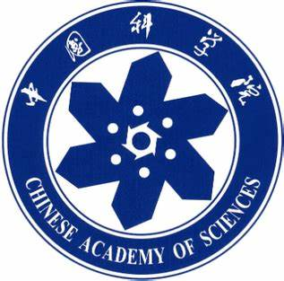
Chongqing University of Technology
ATAI
Advanced Technique of Artificial Intelligence
Chongqing University of Technology
Online Distillation-enhanced Multi-modal Transformerfor Sequential Recommendation
Code: https://github.com/xyliugo/ODMT
—— MM 2023
2023.1.14 • ChongQing
Reported by Peng Shan

Slide 2
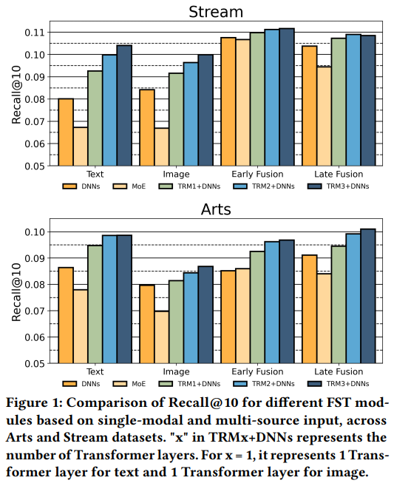
Motivation
Previous studies in multi-modal sequential recommendation models have typically used simple FST modules, such as DNNs and MoE, with Early Fusion or Late Fusion methods。Our exploration experiments reveal that compared to other network structures, Transformers provide better semantic transformation and representation learning for single-modal features。However, the advantage of strong representation brought by Transformers weakens when using multi-source data (ID, text, and image) as input。

Slide 3
Motivation

Slide 4
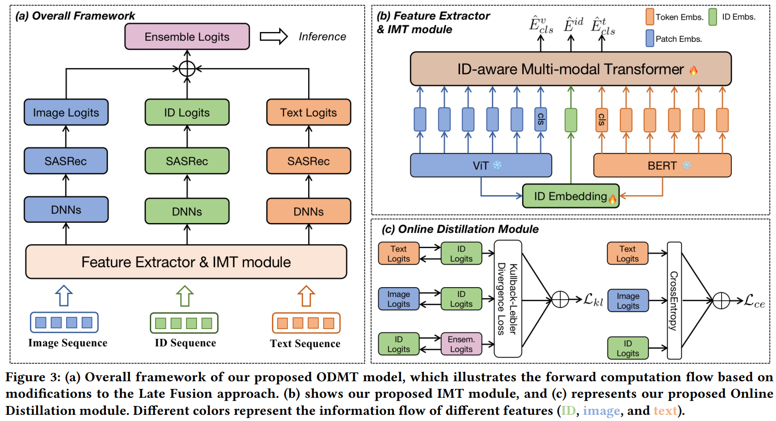
Method

Slide 5
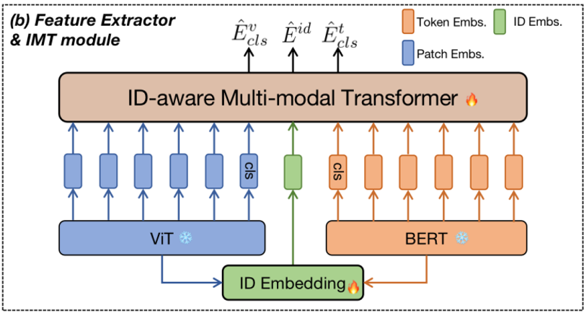
Method

Slide 6
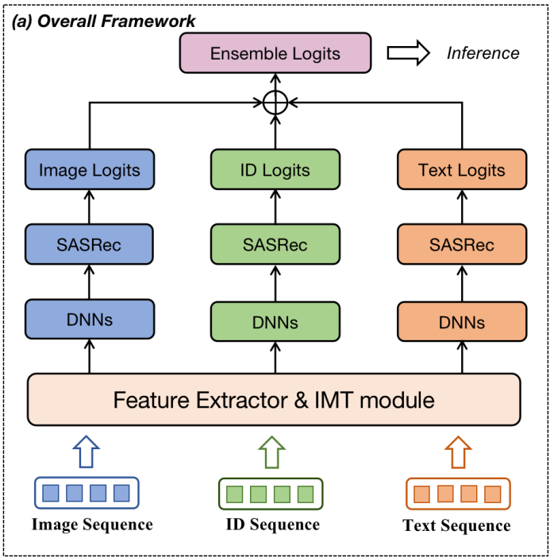
Method

Slide 7
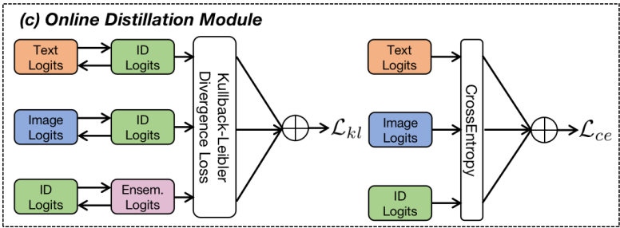
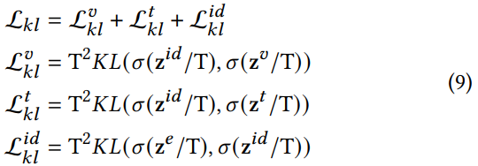
Method

Slide 8
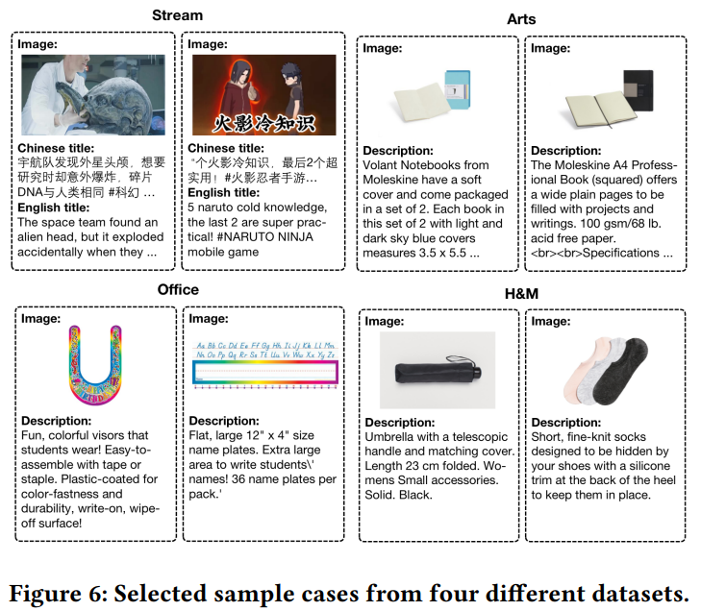
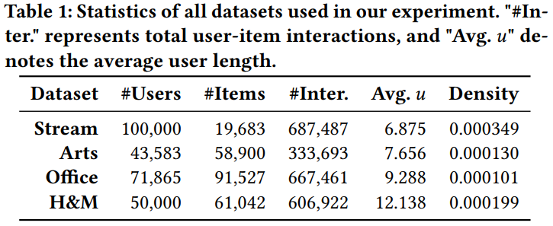
Experiments

Slide 9
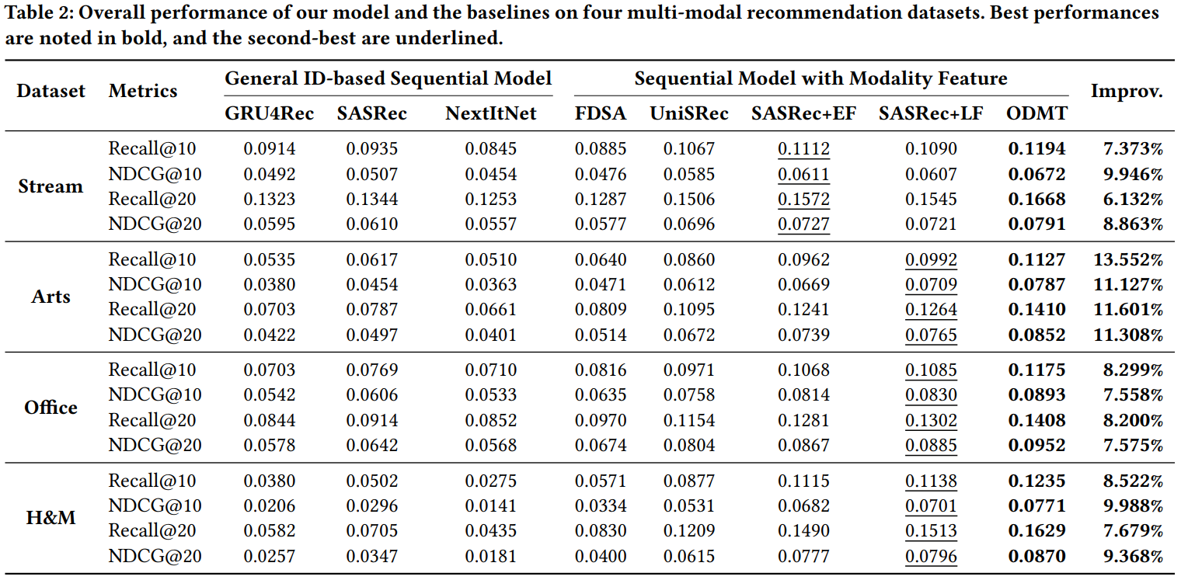
Experiments

Slide 10
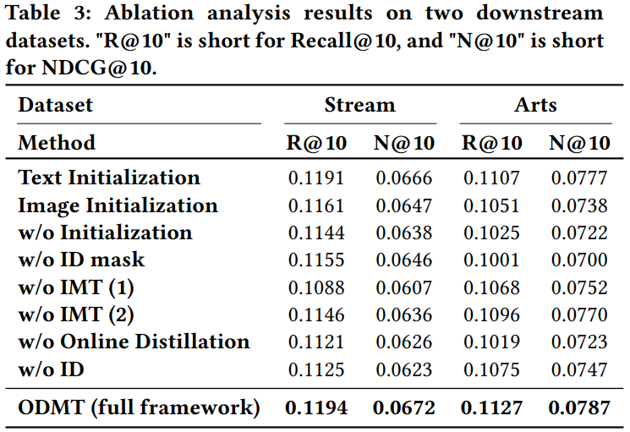
Experiments

Slide 11
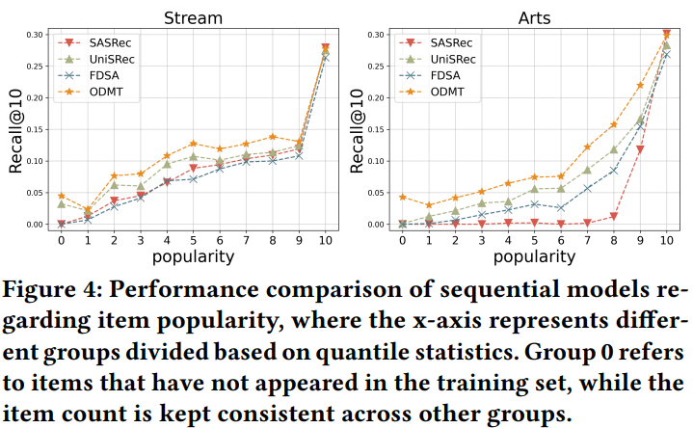
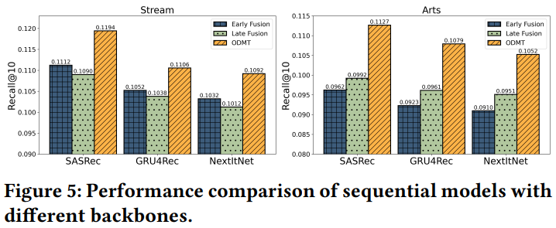
Experiments

Slide 12
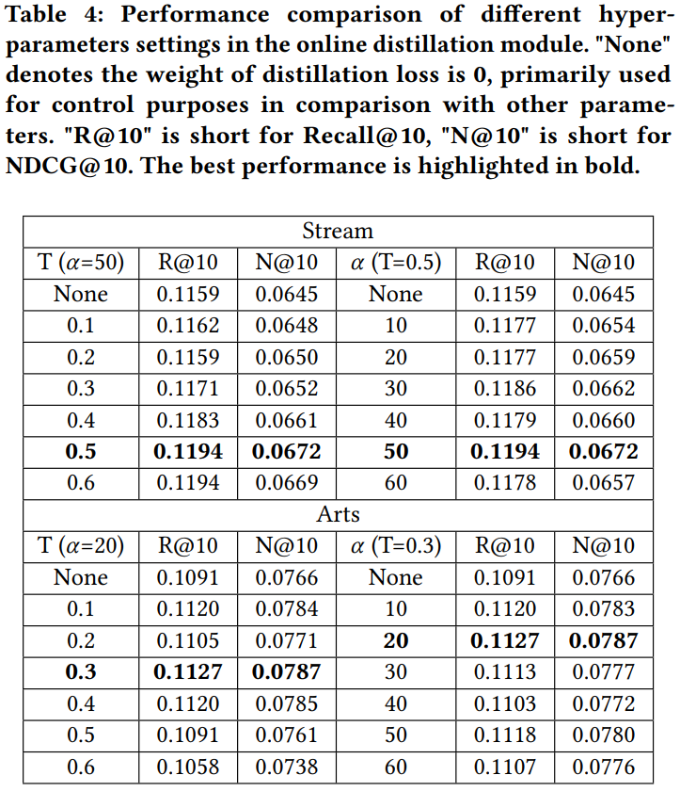
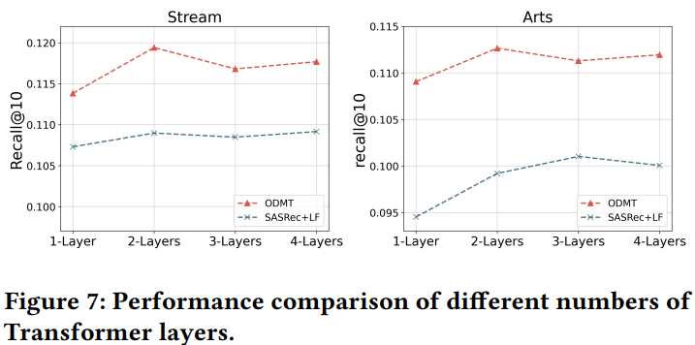
Experiments

Slide 13
Thanks!

